Slide 1
TEAM MEMBERS
Akhand Pratap Mall 2021IMG-003
Aryan Dhull 2021IMG-016
Gaurav Kumar 2021IMG-024
Nandini Ramavath 2021IMG-046
Sarthak Gupta 2021IMG-053
Satyam Agrawal 2021IMG-055

Slide 2
CONTENTS
Overview
ER Diagram
Assumptions
Entity Set
Relationship Sets and Cardinality
Converting ER Diagram to Tables
Functional Dependencies
Decomposition (Using Normalisation)
Final Tables
Tables and Data
Queries in Relational Algebra
Queries in Structured Query Language
Conclusion

Slide 3
Overview
The judiciary is that branch of the government that interprets the law, settles disputes and administers justice to all citizens. The judiciary is considered the watchdog of democracy, and also the guardian of the Constitution. Also it is one of the busiest institutions in our country with there being millions of ongoing and resolved cases. Therefore it becomes important that we have a systematic structure for storing those cases and their details. This database is built for that specific purpose, that is, to have consistent and reliable information about a case. We have also greatly simplified the database such that only the most important details about a case have been stored so that any citizen can easily understand and analyse any case.

Slide 4
E-R Diagrams

Slide 5
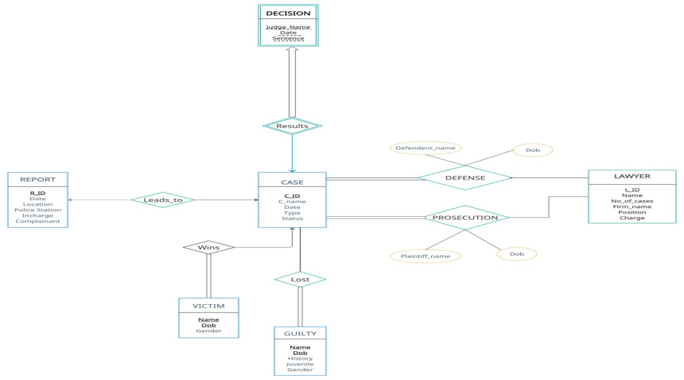

Slide 6
Assumptions
Report is filed at the nearest police station.
Each defendant and plaintiff has his/her own lawyer.
There is no person with same name and date-of-birth.
No one is victim in multiple cases.

Slide 7
Entity Sets
CASE
(C_ID, Cname, Date , Type, Status)
Here C_ID is the primary key of the Case entity set. Date attribute tells about the day when the first hearing of case was started. Type is highest charge against the defendant(for e.g., if the defendant is accused of both murder and robbery, value of Type will be murder). Status is used to represent whether the case is pending or resolved.
REPORT
(R_ID, Date, Location, Police Station, Incharge, Complainant)
R_ID is the primary key of Report entity set. Location is the nearest landmark to the incident. Other attributes give detailed information about the report.

Slide 8
LAWYER
(L_ID, Name, No_of_cases, Firm_name, Position, Charge)
L_ID is the registered license number of the lawyer and the primary key in this set. No_of_cases tells about the number of cases fought by a particular lawyer. Other attributes give information about employment details of the lawyer.
DECISION
(Judge_name, Date, Sentence)
It is a weak entity set identified by the strong entity set Case because there is no existence of a decision without a case. It gives information about the result of the case. Judge_name is the name of the chief judge who will decide the verdict. Sentence is the final verdict of the case.

Slide 9
VICTIM
(Name, Dob, Gender)
Name and Dob is the composite primary key of this entity set as per our assumption discussed in the beginning. It tells about the victims of the case.
GUILTY
(Name, Dob, History, Juvenile, Gender)
Similar to Victim entity set, Name and Dob is the composite primary key of this entity set. History tells about the number of years the person was in jail. Juvenile decides whether the convicted is tried as an adult or child.

Slide 10
Relationship Sets
Results
It is a one to one relationship between Case and Decision entity sets as one case can have at most one decision and one decision can have at most one case associated with it. As Decision is weak entity, there will be total participation from the Decision side and this relationship will be identifying relationship for Decision entity set. There are no descriptive attribute for this relationship set.
Leads_to (R_ID, C_ID)
It is a one to one relationship between Case and Report entity sets as there will be only one case for a given report and one case can have at most one report. There will be partial participation from both the side as there may be several reports where there is no case and all cases may not have report like with civil cases where no report is filed. Any of the R_ID or C_ID can be made primary key of the schema.

Slide 11
DEFENSE (C-ID, L-ID, Defendent_name, Dob)
It is a many to many relationship between Lawyer and Case as there can be multiple lawyers for defendants in the same case and one lawyer can defend in multiple cases. There will be total participation from the Case entity set as a case must have a lawyer for a defendant but there will be partial participation from the Lawyer entity set as a given lawyer may not have defended any one in a case. Also, it contains defendent name and his Dob as descriptive attribute
PROSECUTION(C-ID, L-ID, Plaintiff_name, Dob)
It is a many to many relationship between Lawyer and Case as there can be multiple lawyers for plaintiffs in the same case and one lawyer can play the role of prosecutor multiple cases. All the other things are same as Defense relationship.

Slide 12
WINS (Name, Dob, C-ID)
It is many to one relationship from Victim to Case with Victim on the many side. A case can have multiple victims and one victim can only be associated with one case(as per our assumption). There is total participation from Victim side as there must be a case if there is a victim. It is partial from the Case side as there may not be any victim in a case.
LOST(C-ID, Name, Dob)
It is many to many relationship between Guilty and Case. A case can have multiple guilty and one person can be guilty in multiple cases. It is also total participation from the Guilty side since a person can not be decided to be guilty without a case. It is partial participation from Case side as a case may not find any person guilty.

Slide 13
Converting E-R Diagram to Schemas and Removing Redundancies

Slide 14
Schemas
Case
As Case is a strong entity, it can be directly converted into schema with same attributes.
Case(C-ID, Cname, Date , Type, Status)
Decision
As Decision is a weak entity set, it will contain primary key of Case(C-ID) as its foreign key.
Decision(C-ID, Judge_name, Date, Sentence)

Slide 15
Following schemas are strong entity sets so they will be converted directly into tables​
Lawyer(L-ID, Name, No_of_cases, Firm, Position, Charge)
Report(R-ID, Date, Location, Police Station, Incharge, Complainant, C-ID)
Victim(Name, Dob, Gender, C-ID)
Guilty(Name, Dob, History, Juvenile, Gender)

Slide 16
Result
Since Result is a one-one relationship between Decision and Case, there will be no additional table for Result and it will be merged into Decision table with C-ID as primary key.
Leads_to
Similar to Result relationship set, there will be no additional table for Leads_to and the primary key of Case(C-ID) will act as foreign key in Report table.

Slide 17
WINS
Since it is a many to one relationship, we don’t need an additional table to represent it and it can be merged with table on many side. In this case, it will be merged with the Victim schema.
LOST
Lost is a many to many relationship between Case and Guilty. It will be converted into a new schema having primary key of both the table as its composite primary key.
Lost(C-ID, Name, Dob)

Slide 18
DEFENSE
As it is a many to many relationship between Case and Lawyer, it will be converted into its own schema having C-ID and L-ID as its composite primary key. Other descriptive attributes will remain as it is.
Defense(C-ID, L-ID, Defendent_name, Dob)
PROSECUTION
Similar to Defense relationship, it will also be converted into its own schema with C-ID and L-ID as its composite primary key.
Prosecution(C-ID, L-ID, Plaintiff_name, Dob)

Slide 19
Functional Dependencies

Slide 20
SCHEMA | FUNCTIONAL DEPENDENCIES
CASE | C-ID → Cname, Date , Type, Status
LAWYER | L-ID → No_of_cases, Firm, Position, Charge Firm, Position → Charge
REPORT | R-ID → Date, Location, Police Station, Incharge, Complainant Location→ Police Station
VICTIM | Name, Dob → Gender
GUILTY | Name, Dob → History, Juvenile, Gender Dob → Juvenile
PROSECUTION | C-ID, L-ID → Plaintiff_name, Dob
DEFENSE | C-ID, L-ID → Defendent_name, Dob
LOST | ---------------------------------------------------------------------
DECISION | -------------------------------------------------------------------

Slide 21
Decomposition using Normalization
CASE
FDs: C-ID -->Cname, Date , Type, Status
1NF: Since all attributes are considered to be atomic, the schema is in 1NF.
2NF: As there is no composite primary key, hence no partial dependency, therefore the schema is also in 2NF.
3NF: As the only functional dependency is between primary key and other non-prime attributes, i.e., that is no transitive dependency, the schema is also in 3NF.
BCNF: Since all attributes on the LHS of the functional dependencies are candidate keys , the schema is also in BCNF.

Slide 22
LAWYER
FDS: L-ID -> No_of_cases, Firm, Position, Charge
Firm, Position -> Charge
1 NF: As all attributes are assumed to be atomic, the given schema is in First Normal Form.
2 NF: Since there is no composite primary key, no partial dependency exists, and hence, the schema is in Second Normal Form.
3 NF: The schema is not in 3NF as transitive dependency exists:
L-ID ->Firm, Position, Charge
Firm, Position -> Charge
Therefore we need to decompose Lawyer into two schemas:
Lawyer (L-ID, No_of_cases, Firm, Position)
LawyerFee (Firm, Position, Charge)
Functional dependencies are: Lawyer(L-ID --> No_of_cases, Firm, Position)
LawyerFee (Firm, Position -> Charge)
BCNF: As no non-prime attribute is on the LHS of a functional dependency therefore both the schemas are in BCNF.

Slide 23
VICTIM
FDs: Name, Dob -> Gender
1 NF: Since all the attributes are considered to be atomic, the schema is in First Normal Form.
2 NF: As no attribute is defined by part of a primary key, therefore no partial dependency exists, hence, the schema is in Second Normal Form.
3 NF: No non-prime attribute determines any other non-prime attribute, i.e., no transitive dependency exists. Schema is in Third Normal Form.
BCNF: Since all attributes on the LHS of the functional dependencies are candidate keys , the schema is in BCNF.

Slide 24
PROSECUTION
FDs: C-ID, L-ID -> Plaintiff_name, Dob
1 NF: All attributes are atomic, hence, the schema is in First Normal Form.
2 NF: As no non-prime attribute is determined by part of the primary key, hence the schema is in Second Normal Form.
3 NF: As there is no transitive dependency, therefore the schema is in Third Normal Form.
BCNF: Since all attributes on the LHS of the functional dependencies are candidate keys , the schema is in BCNF.

Slide 25
DEFENSE
FDs: C-ID,L-ID -> Defendent_name, Dob
1 NF: All attributes are atomic, hence, the schema is in First Normal Form.
2 NF: As no non-prime attribute is determined by part of the primary key, hence the schema is in Second Normal Form.
3 NF: As there is no transitive dependency, therefore the schema is in Third Normal Form.
BCNF: Since all attributes on the LHS of the functional dependencies are candidate keys , the schema is in BCNF.

Slide 26
REPORT
FDs: R-ID -> Date, Location, Police Station, Incharge, Complainant
Location -> Police Station
1NF: Since all attributes are assumed to be atomic, hence the schema is in First Normal Form.
2 NF: As primary key is made up of single attribute, therefore no partial dependency does not exist, so, the schema is in Second Normal Form.
3 NF:R-ID -> Location, Police Station
Location ->Police Station
The schema is not in 3 NF as transitive dependency exist, to convert the schema into Third Normal Form, we will decompose it into two schemas
Report (R-ID, Date, Location, Incharge, Complainant)
NearestPoliceStation(Location, Police Station)
Now the functional dependencies are: Report(R-ID ->Date, Location, Incharge, Complainant)
NearestPoliceStation( Location -> Police Station)
BCNF: The schemas are in BCNF as all functional dependencies have candidate key on the LHS.

Slide 27
GUILTY
FDs: Name, Dob -> History, Juvenile, Gender
Dob -> Juvenile
1 NF: As all attributes are assumed to be atomic, hence the schema is in First Normal Form
2 NF: The schema is not in 2 NF as partial dependency exists as,
Name, Dob -> History, Juvenile, Gender
Dob -> Juvenile
Part of the primary key determines another attribute
To convert the schema into Second Normal Form, we will decompose it into two schemas:
Guilty(Name, Dob, History, Gender)
isJuvenile(Dob, Juvenile)
3 NF: Both the schemas are in Third Normal Form as no transitive dependency exists.
BCNF: Since only primary key is one the LHS of the functional dependency in both the schemas, the schemas are in BCNF.

Slide 28
Final Tables
Case(C-ID, Cname, Date , Type, Status)
Decision(C-ID, Judge_name, Date, Sentence)
Victim(Name, Dob, Gender)
Defense(C-ID, L-ID, Defendent_name, Dob)
Prosecution(C-ID, L-ID, Plaintiff_name, Dob)
Lost(C-ID, Name, Dob)
Guilty(Name, Dob, History, Gender)
isJuvenile(Dob, Juvenile)
Report(R-ID, Date, Location, Incharge, Complainant)
NearestPoliceStation( Location, Police Station)
Lawyer (L-ID, No_of_cases, Firm, Position)
LawyerFee (Firm, Position, Charge)

Slide 29
Tables and their Data

Slide 30
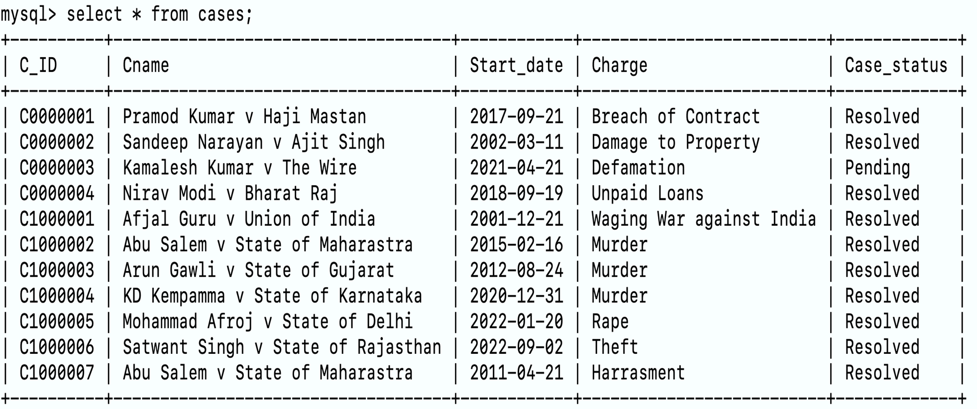
cases

Slide 31
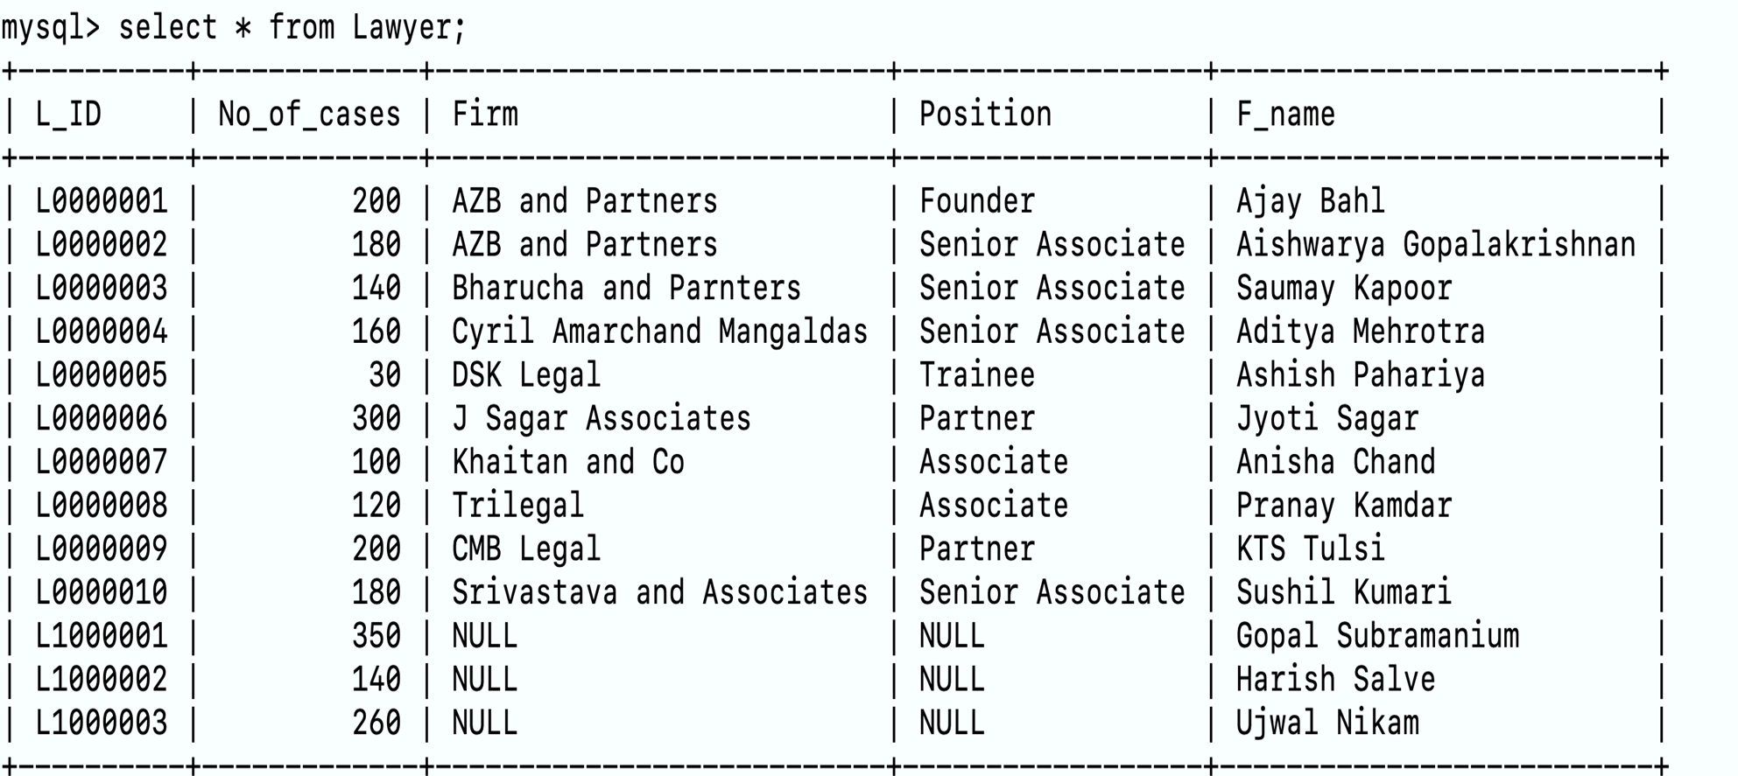
Lawyer

Slide 32
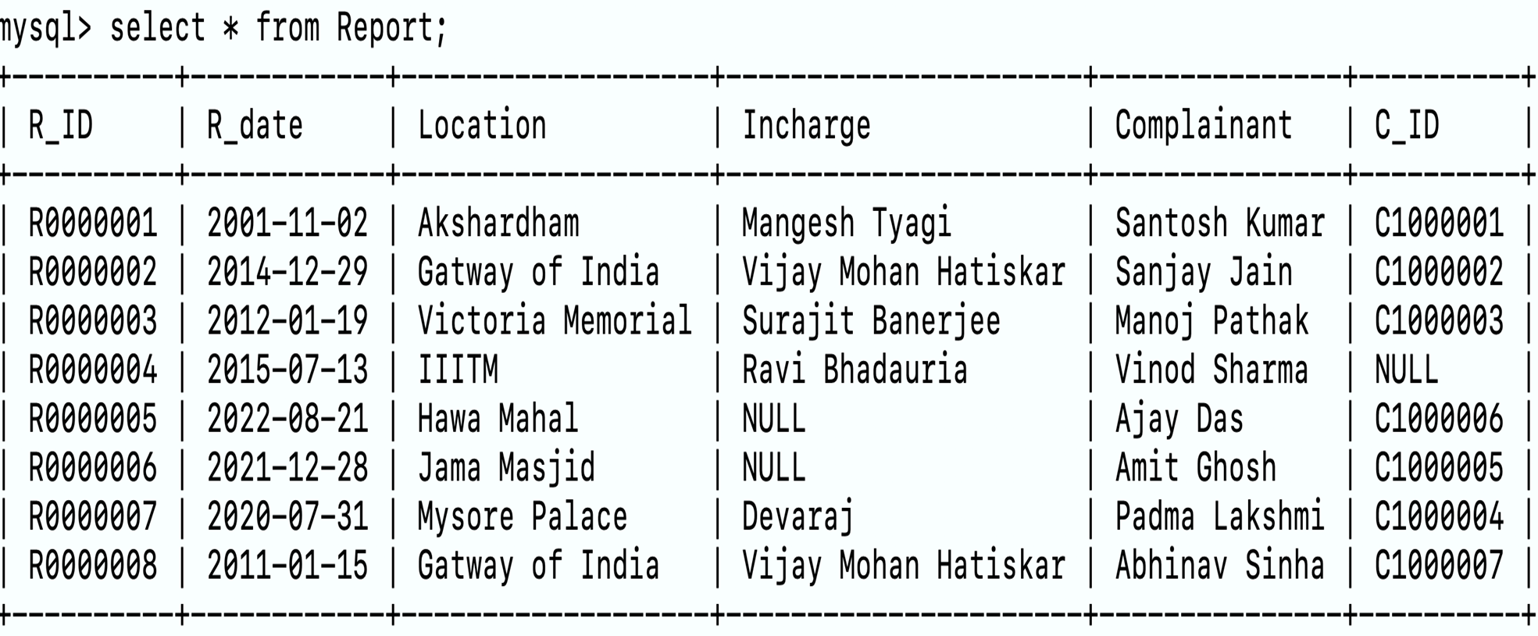
Report

Slide 33
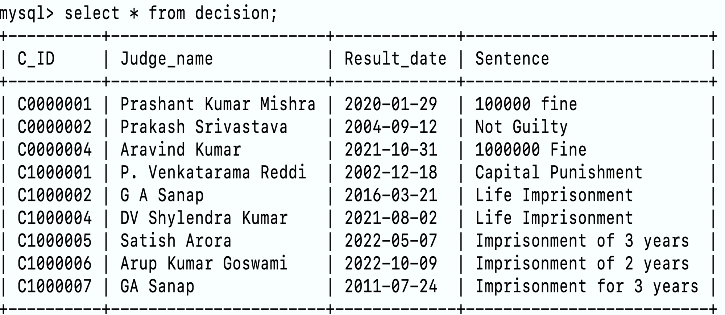
decision

Slide 34
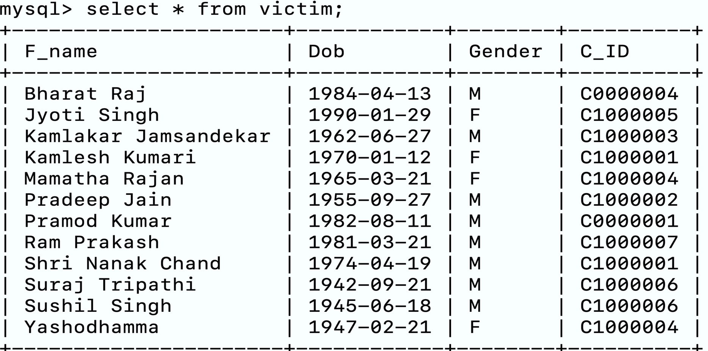
victim

Slide 35
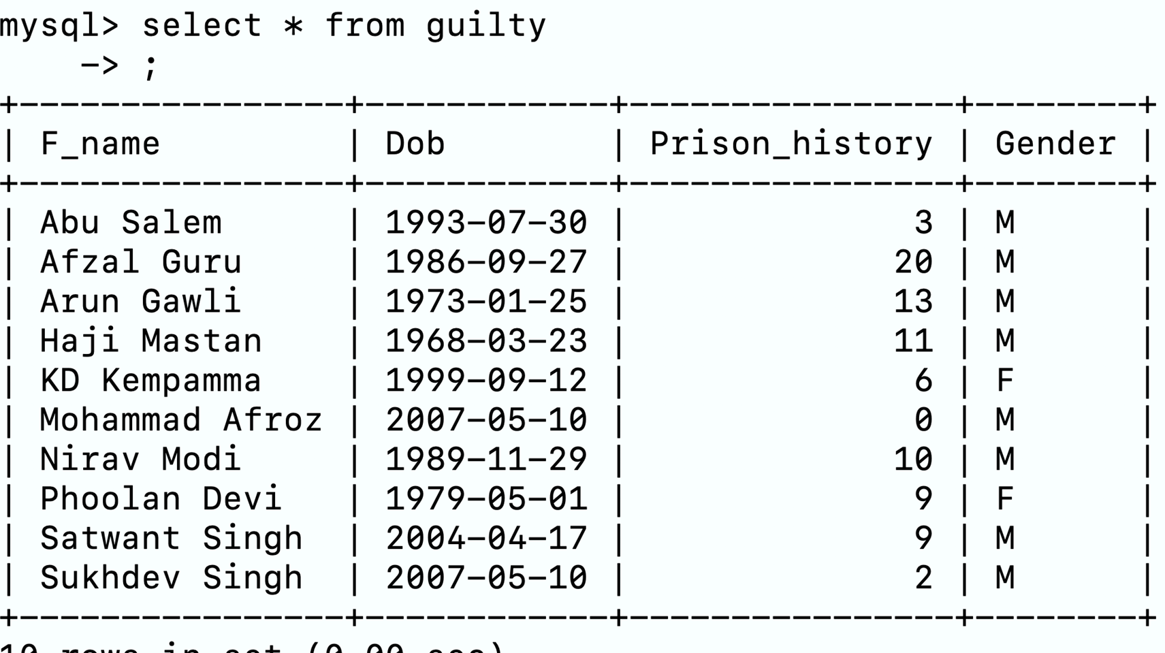
guilty

Slide 36
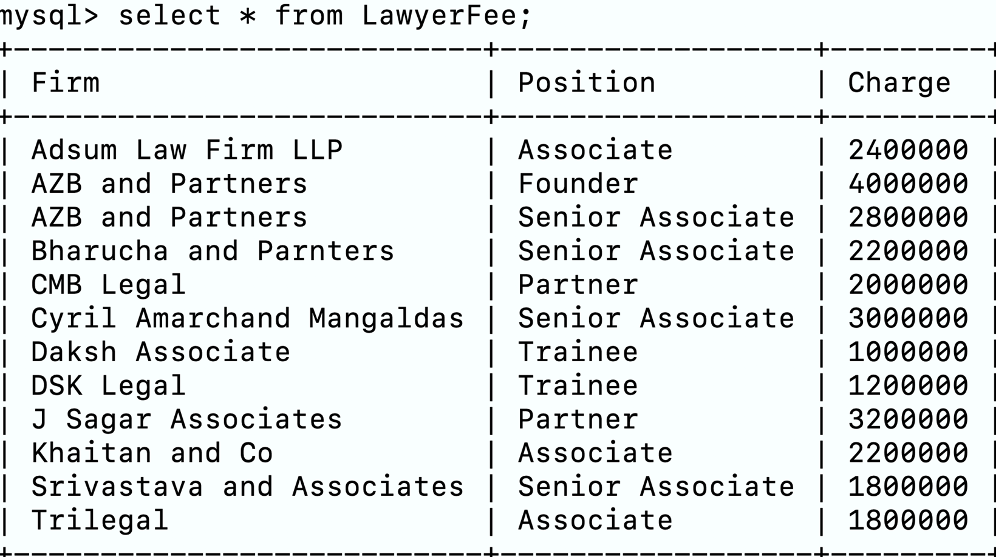
LawyerFee

Slide 37
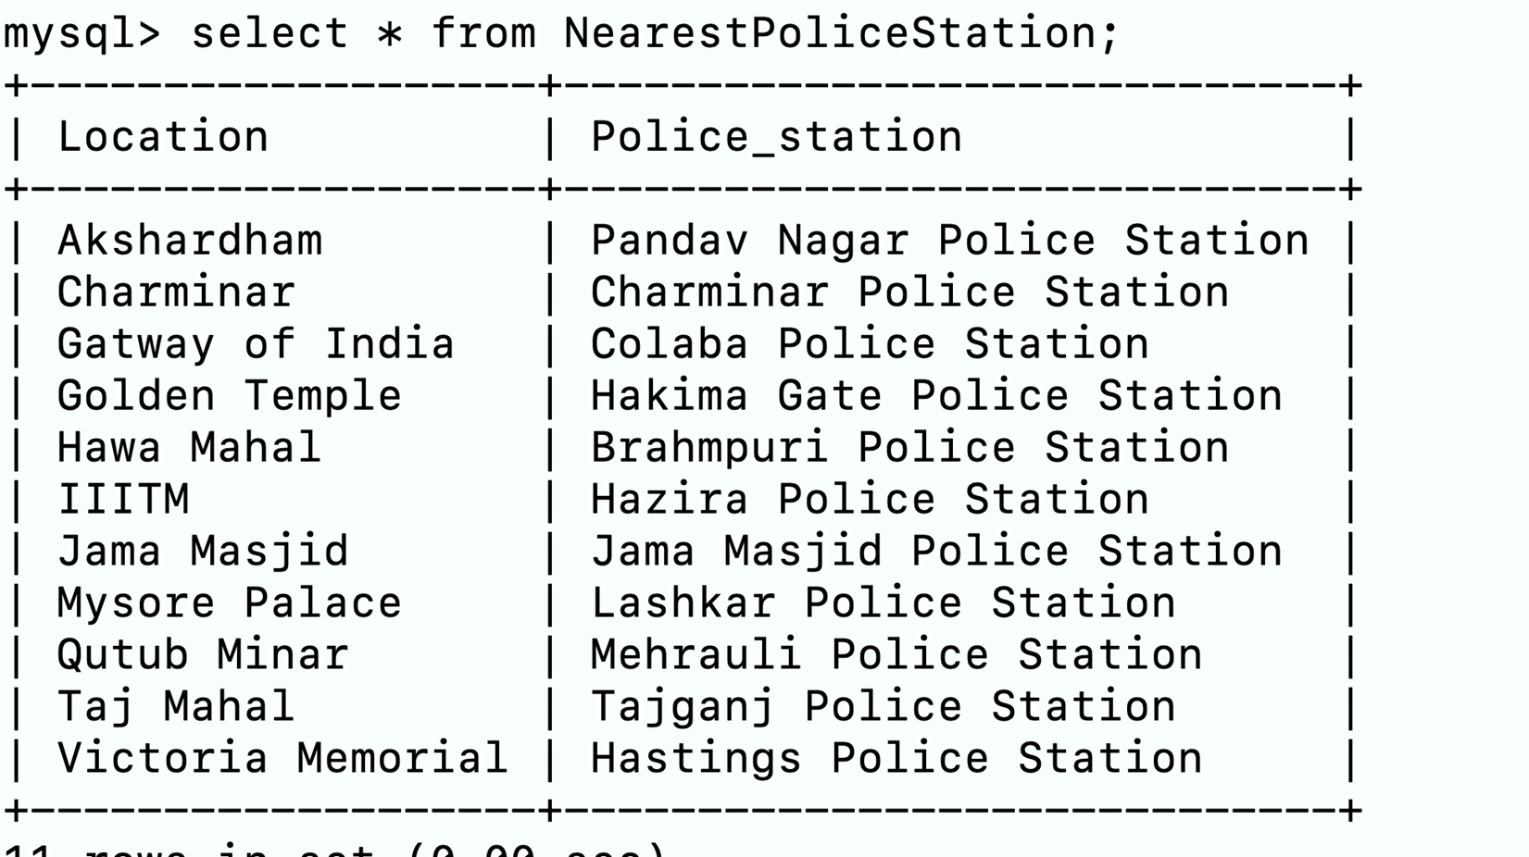
NearestPoliceStation

Slide 38
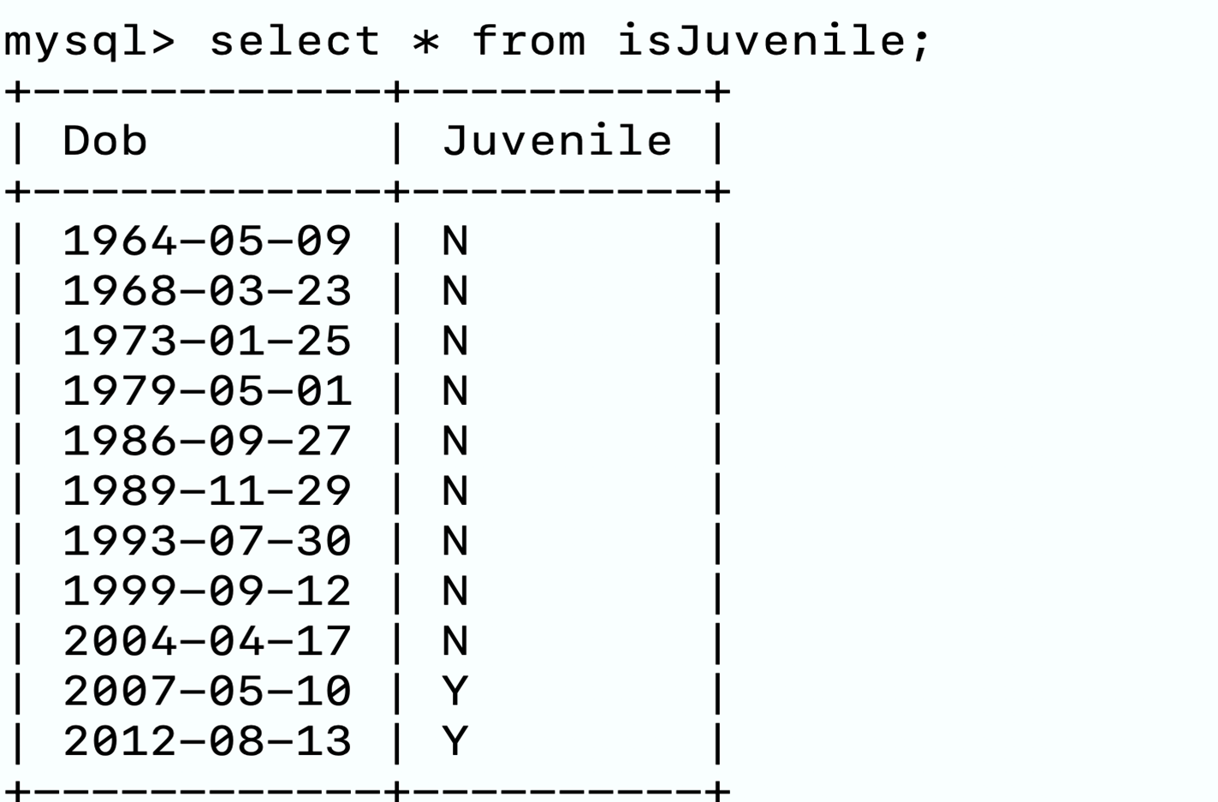
isJuvenile

Slide 39
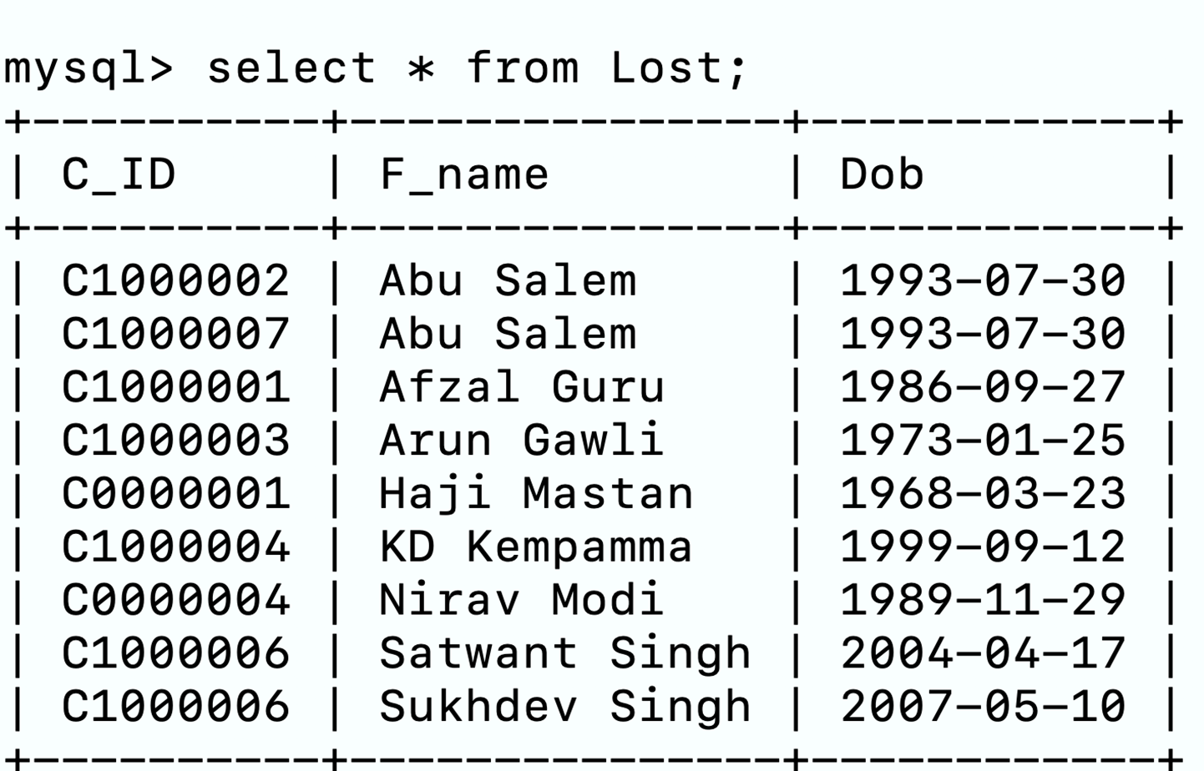
Lost

Slide 40
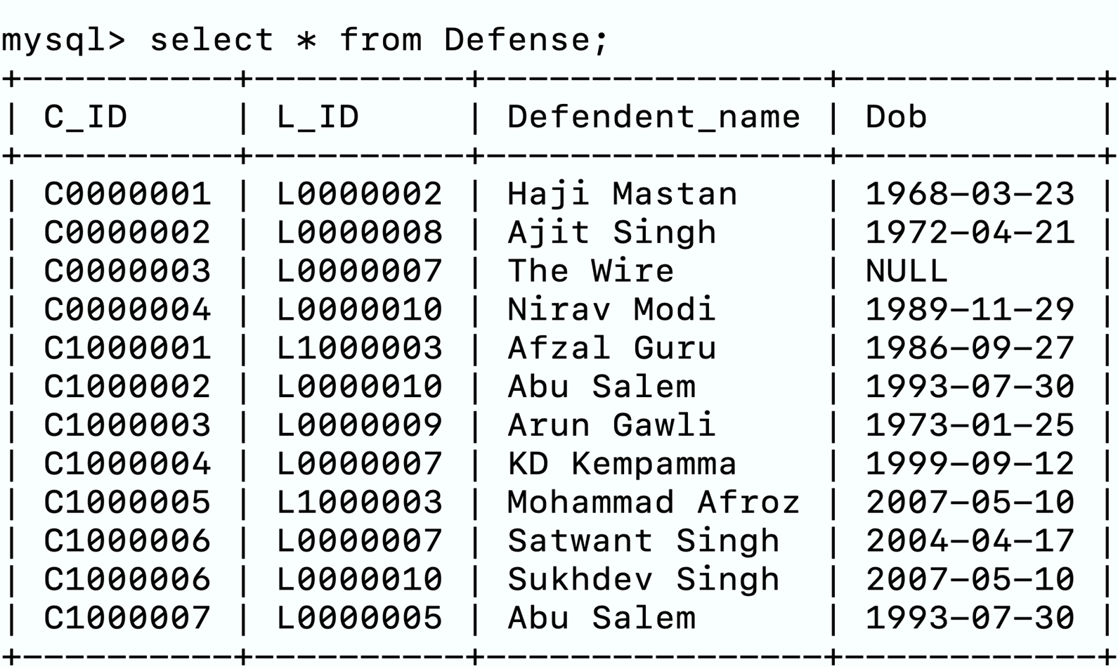
Defense

Slide 41
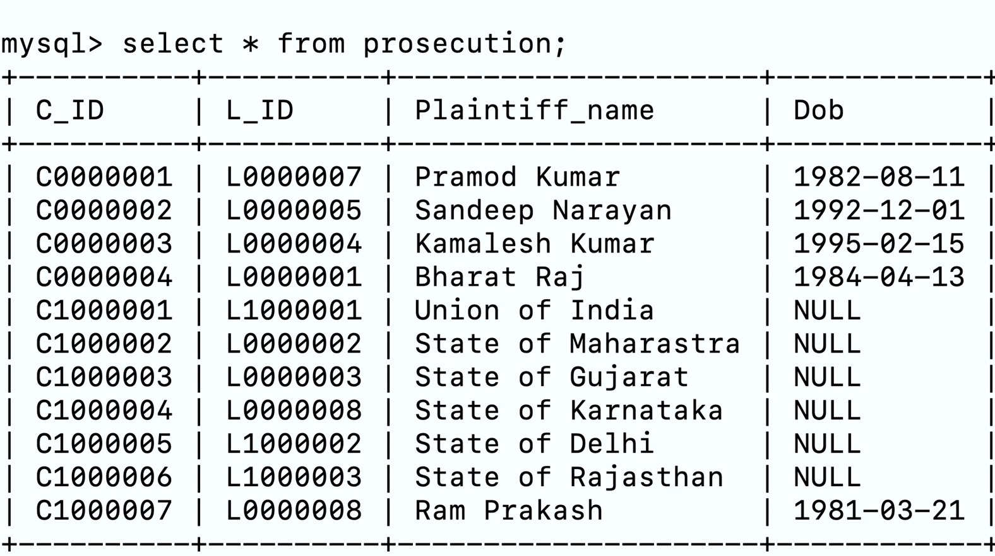
prosecution

Slide 42
SQL Queries

Slide 43
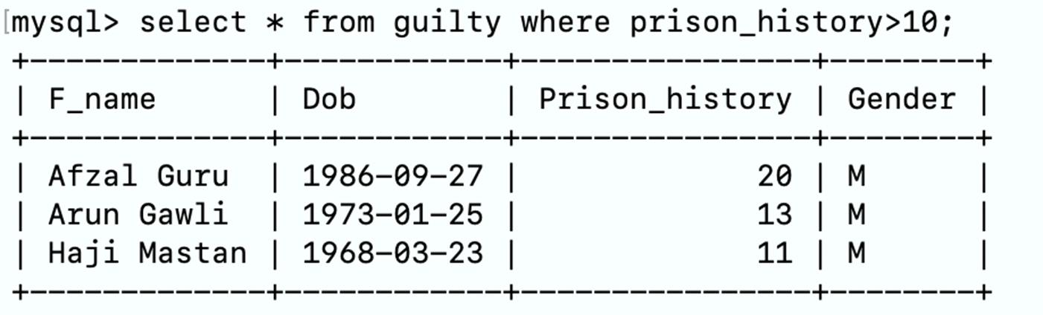
Display all convicts who spent 10 or more years in Jail.

Slide 44
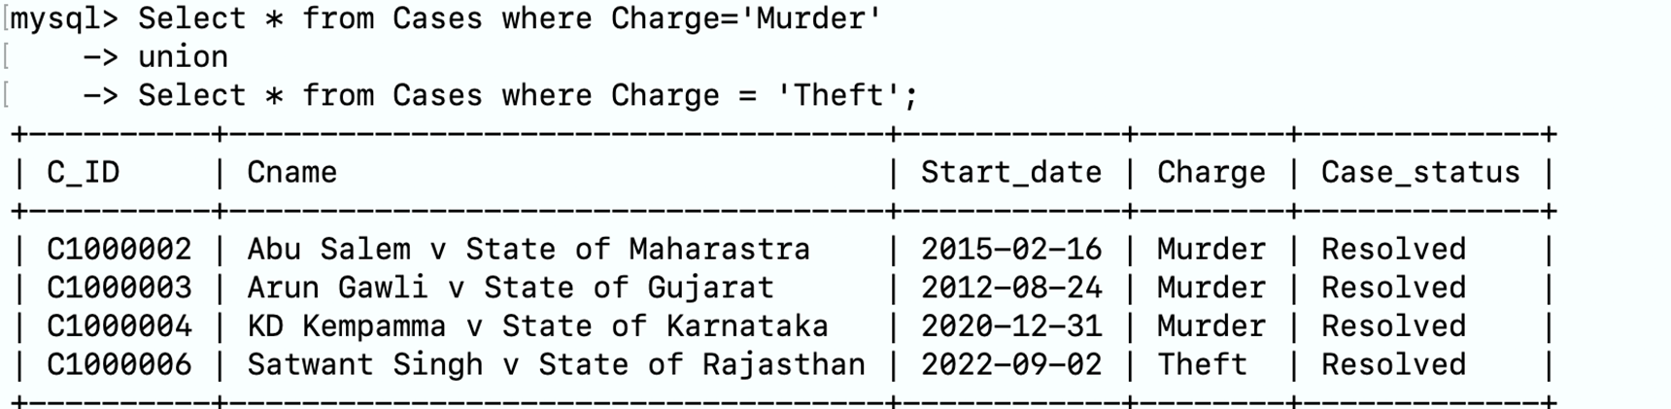
Display case details where crime was Murder or Theft.

Slide 45
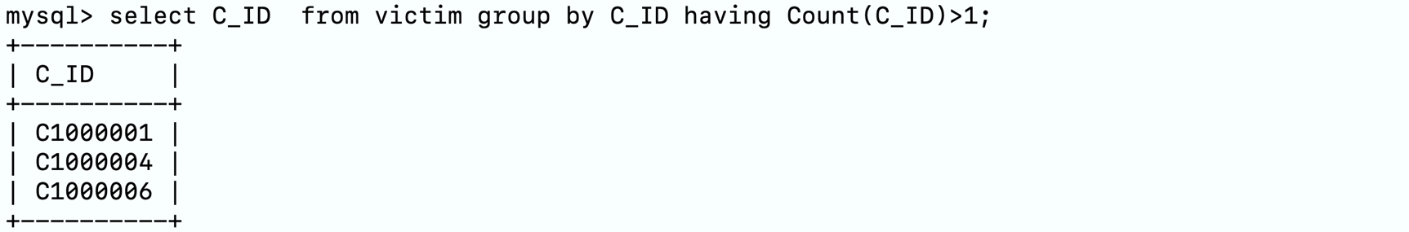
Display all cases where there were multiple victims.

Slide 46
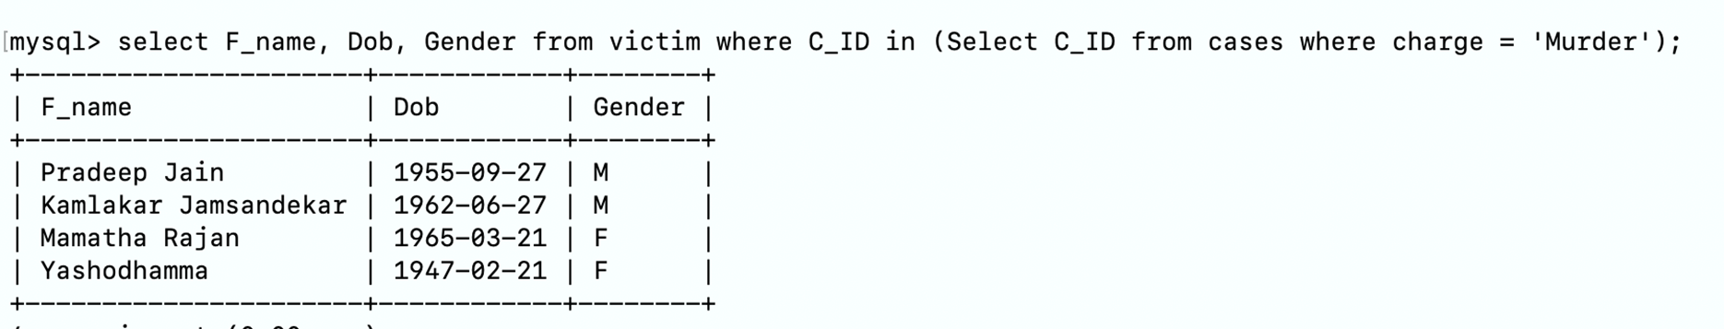
Display all persons who were murdered.

Slide 47
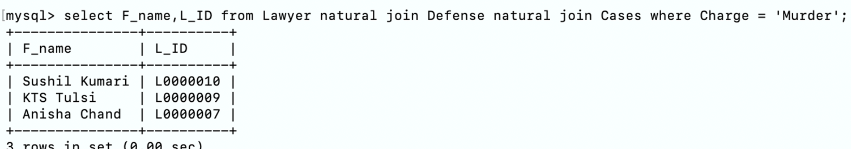
Show Lawyers who defended clients accused of murder.

Slide 48
RELAX Queries

Slide 49
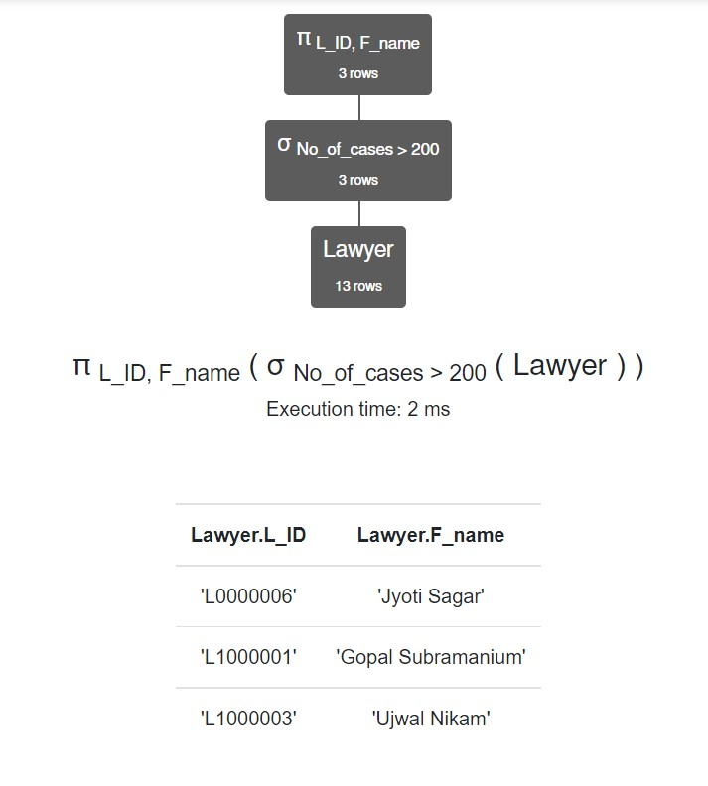
Show All Lawyer's ID,name who have fought the cases greater than 200.

Slide 50
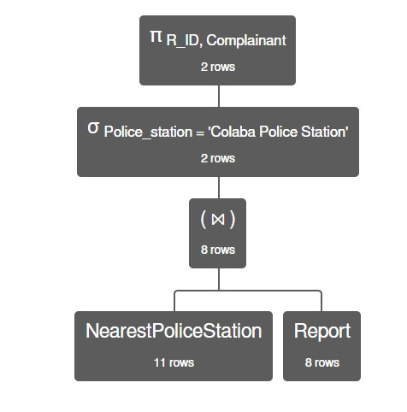
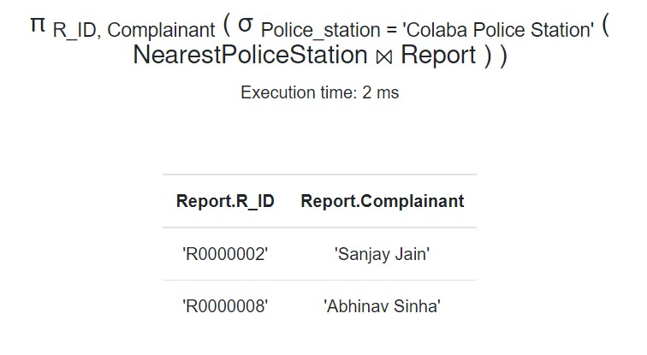
Show All Report's ID, Complainant that are filed at Colaba Police Station.

Slide 51
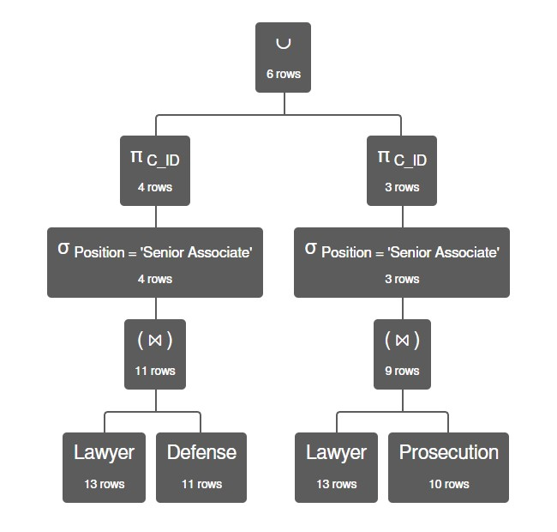
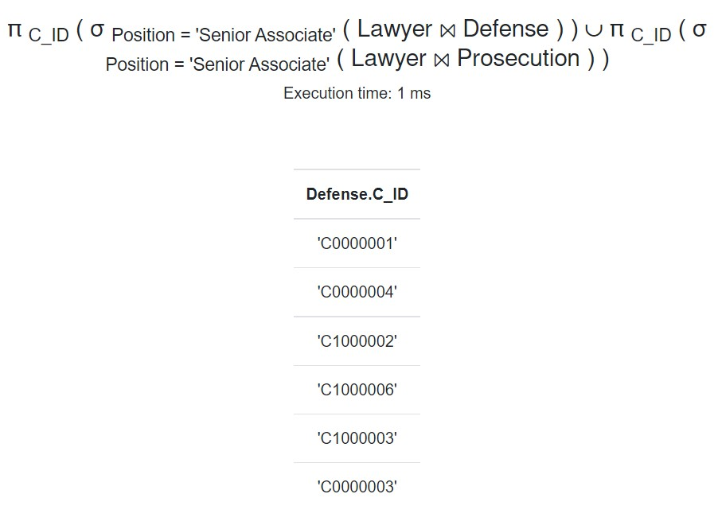
Show all the Case's ID that are fought by Lawyers at Senior Associate position.

Slide 52
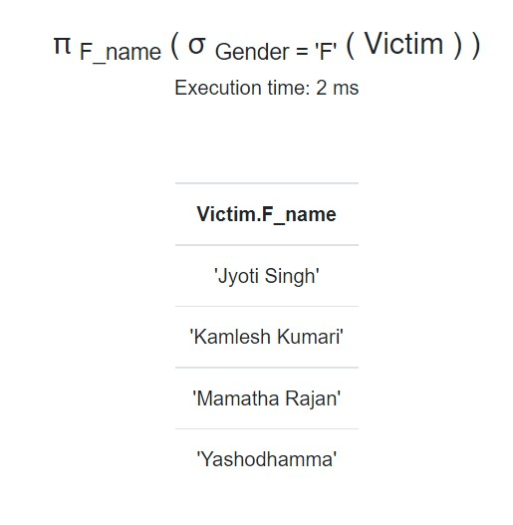
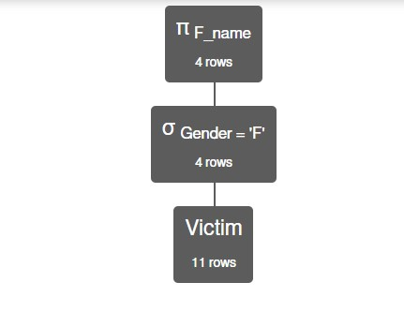
Show the names of all female victims.

Slide 53
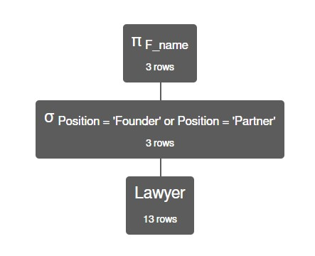
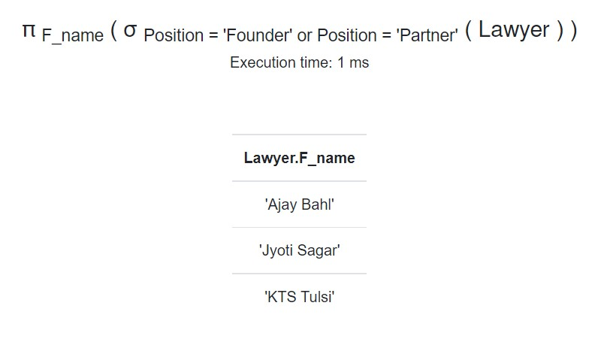
Show All Lawyer's name who are at the position of Founder or Partner.

Slide 54
Thank You Very Much!
For Your Attention

